Slide 1


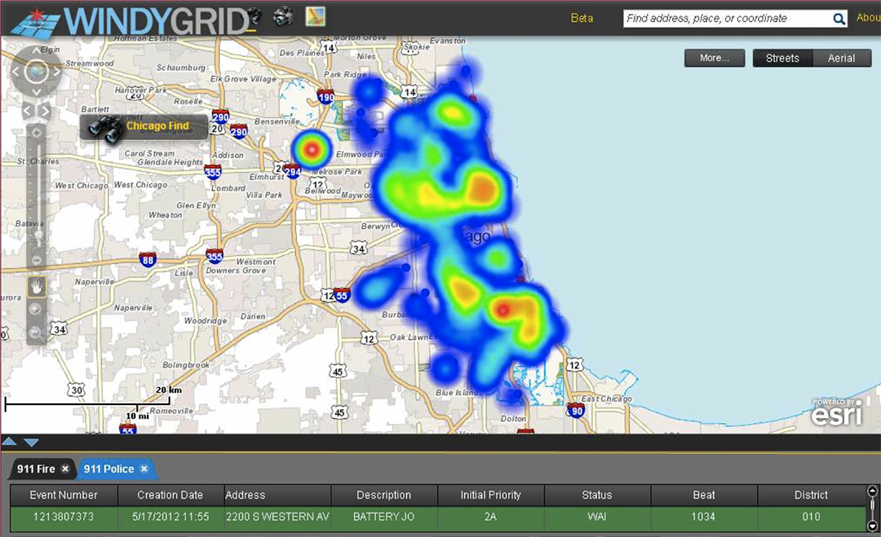


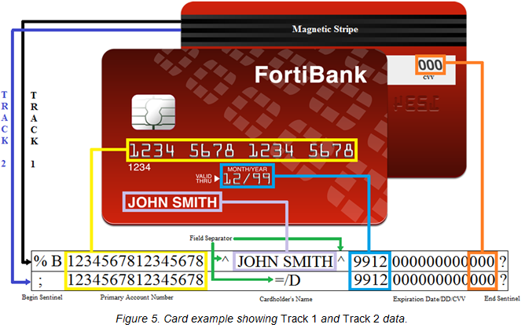





DATA:THE NEW ASSET CLASS
Sallie Keller, Aaron Schroeder, Stephanie Shipp, David Higdon,
Gizem Korkmaz,Emily Molfino, Mark Orr, Bianica Pires, Katie Ziemer
Data Types
Designed Data Collections
Statistically designed and intentional observational data collections
Administrative Data
Data collected for the administration of an organization or program
Opportunity Data
Data generated as we move through our daily paces
Procedural Data
Data derived from policies and procedures
Veracity and Value
Social and Behavioral Data Flows
Governance, Structure, and Quality
Challenge and Opportunities
bi.vt.edu/sdal

